Slide 1

Subway Surfer
By Reece Reklai

Slide 2
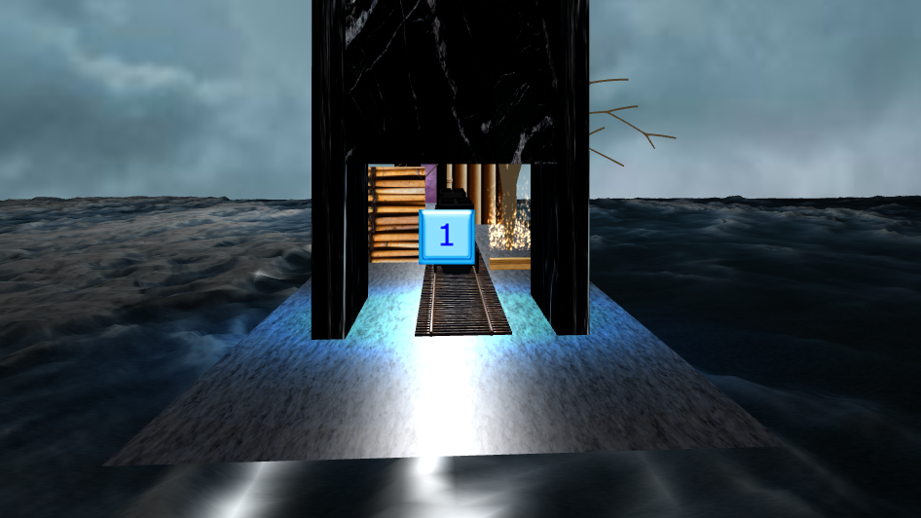

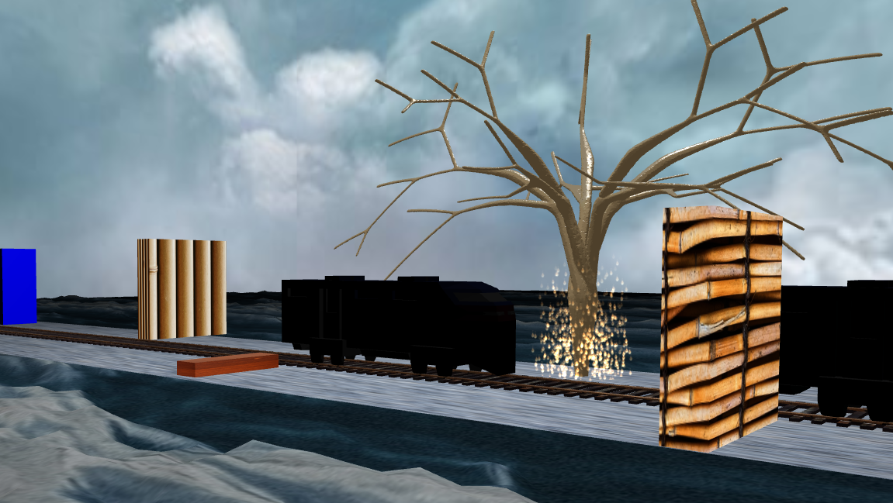
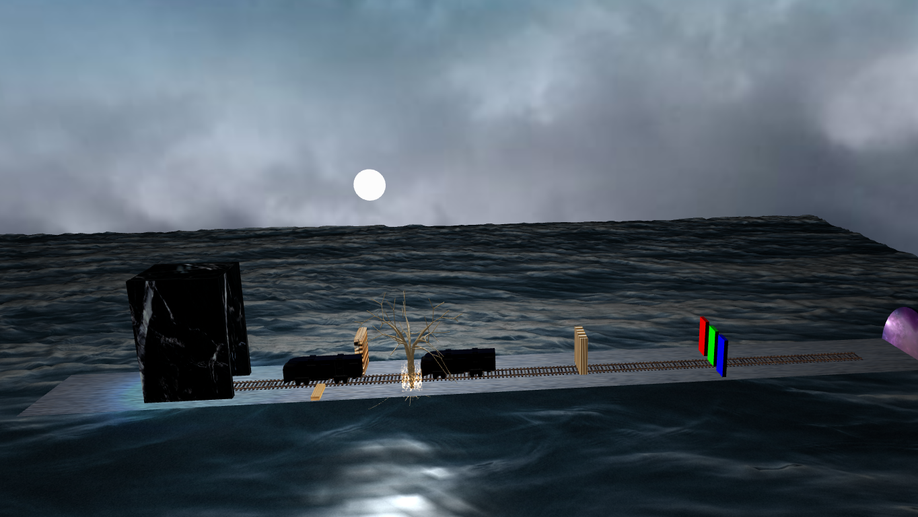
Shapes

Slide 3
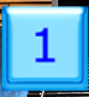
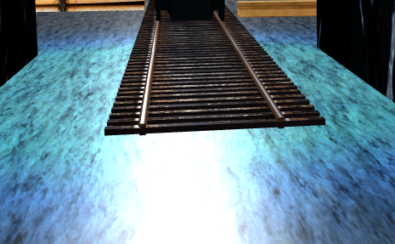
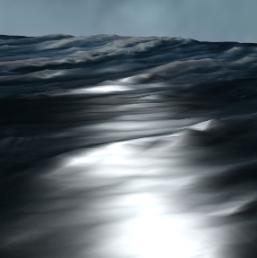
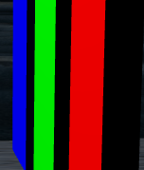
Lights, Shadows, Sprite

Slide 4
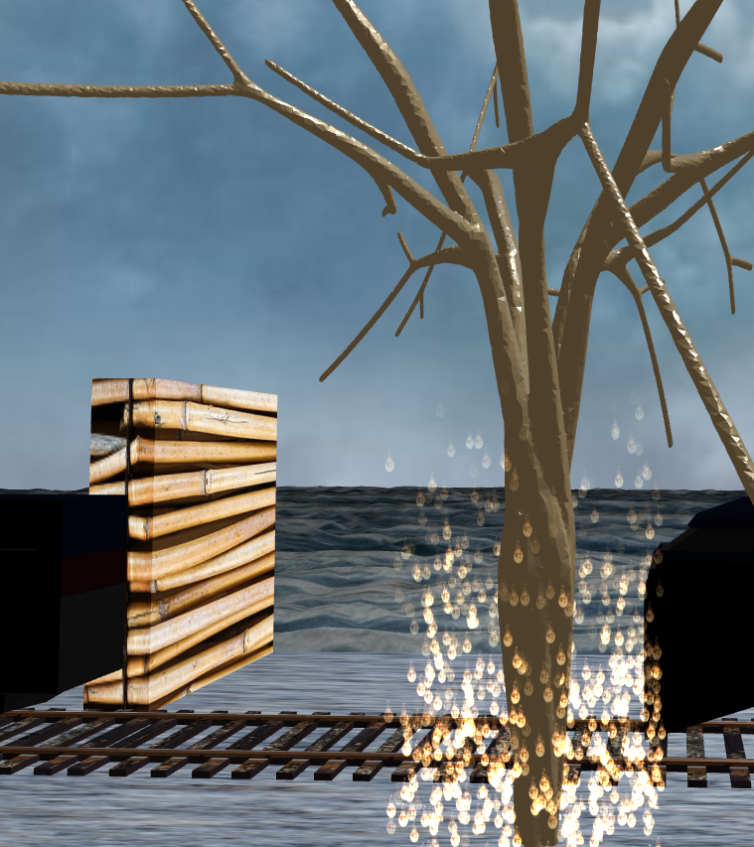
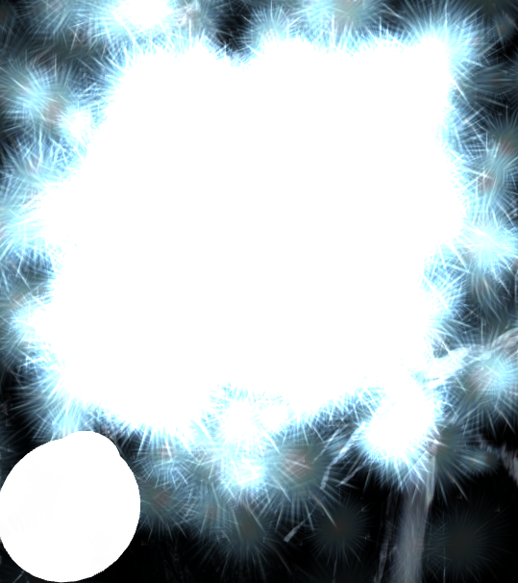
Particles

Slide 5

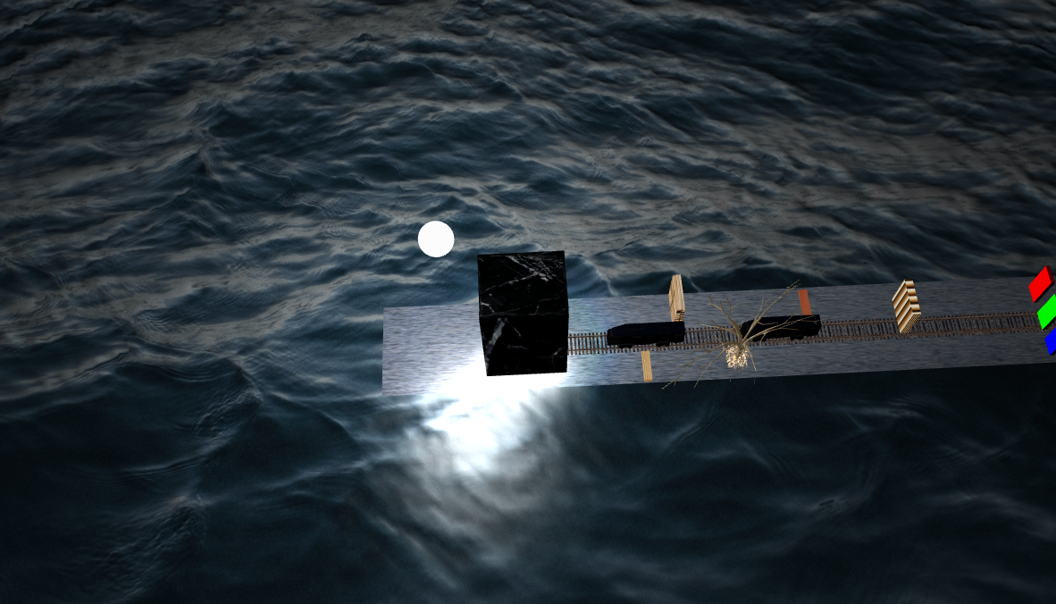
Sky Box and Height Map

Slide 6
Audio
Subway Surfer Theme

Slide 7
More Depth
Camera Mechanic
W – forward, A – left, D – right
Spacebar Jump
Camera Locked onto target
Light/Shadow
HeightMap Shadows
Tunnel Shadows
Tunnel Light
Sun Light
Blender Objects
Train, Tunnel, Ground
Railroad, Boxes, Walls, Lightbulbs
Tree, Portal

Slide 8
Problems
I was not able to find out why I cannot use GUI
I was supposed to use Gimp and Inkscape on my GUI
I did not use physics

